Slide 1
Post-Market surveillance of Illumina products
Ivan Charkin, Jeff Leath, Alec Neff
MSDS 7330 project
April 16, 2019

Slide 2
Summary
I
For this project we collected post-market data on the performance of products made by Illumina
The data were obtained by collecting tweets related to the company products from Twitter using a custom Python script
The tweets were organized in a MongoDB database for further analysis and custom summaries
Simple Natural Language Processing analysis of the tweets collected in the database was demonstrated

Slide 3
Summary
I
For this project we collected post-market data on the performance of products made by Illumina
The data were obtained by collecting tweets related to the company products from Twitter using a custom Python script
The tweets were organized in a MongoDB database for further analysis and custom summaries
Simple Natural Language Processing analysis of the tweets collected in the database was demonstrated

Slide 4
Summary
I
For this project we collected post-market data on the performance of products made by Illumina
The data were obtained by collecting tweets related to the company products from Twitter using a custom Python script
The tweets were organized in a MongoDB database for further analysis and custom summaries
Simple Natural Language Processing analysis of the tweets collected in the database was demonstrated

Slide 5
Summary
I
For this project we collected post-market data on the performance of products made by Illumina
The data were obtained by collecting tweets related to the company products from Twitter using a custom Python script
The tweets were organized in a MongoDB database for further analysis and custom summaries
Simple Natural Language Processing analysis of the tweets collected in the database was demonstrated

Slide 6
Summary
I
For this project we collected post-market data on the performance of products made by Illumina
The data were obtained by collecting tweets related to the company products from Twitter using a custom Python script
The tweets were organized in a MongoDB database for further analysis and custom summaries
Simple Natural Language Processing analysis of the tweets collected in the database was demonstrated

Slide 7
Summary
I
For this project we collected post-market data on the performance of products made by Illumina
The data were obtained by collecting tweets related to the company products from Twitter using a custom Python script
The tweets were organized in a MongoDB database for further analysis and custom summaries
Simple Natural Language Processing analysis of the tweets collected in the database was demonstrated

Slide 8
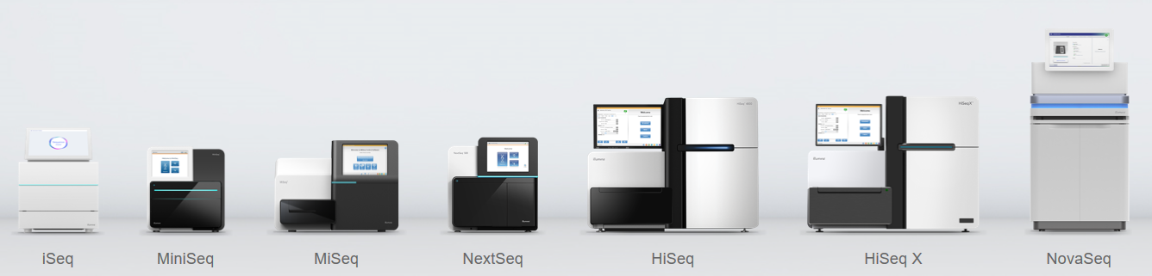
Illumina
I
Illumina is a leading company in the DNA sequencing market
It produces multiple platforms of DNA sequencers for various applications and consumables used for sequencing runs
The products are used for both research and medical diagnostics purposes (e.g. in-vitro diagnostics, cancer research)
www.illumina.com

Slide 9
Illumina
I
Illumina is a leading company in the DNA sequencing market
It produces multiple platforms of DNA sequencers for various applications and consumables used for sequencing runs
The products are used for both research and medical diagnostics purposes (e.g. in-vitro diagnostics, cancer research)
www.illumina.com

Slide 10
Illumina
I
Illumina is a leading company in the DNA sequencing market
It produces multiple platforms of DNA sequencers for various applications and consumables used for sequencing runs
The products are used for both research and medical diagnostics purposes (e.g. in-vitro diagnostics, cancer research)
www.illumina.com

Slide 11
Illumina
I
Illumina is a leading company in the DNA sequencing market
It produces multiple platforms of DNA sequencers for various applications and consumables used for sequencing runs
The products are used for both research and medical diagnostics purposes (e.g. in-vitro diagnostics, cancer research)
www.illumina.com

Slide 12
Illumina
I
Illumina is a leading company in the DNA sequencing market
It produces multiple platforms of DNA sequencers for various applications and consumables used for sequencing runs
The products are used for both research and medical diagnostics purposes (e.g. in-vitro diagnostics, cancer research)
www.illumina.com

Slide 13
Illumina
I
Illumina is a leading company in the DNA sequencing market
It produces multiple platforms of DNA sequencers for various applications and consumables used for sequencing runs
The products are used for both research and medical diagnostics purposes (e.g. in-vitro diagnostics, cancer research)
www.illumina.com

Slide 14

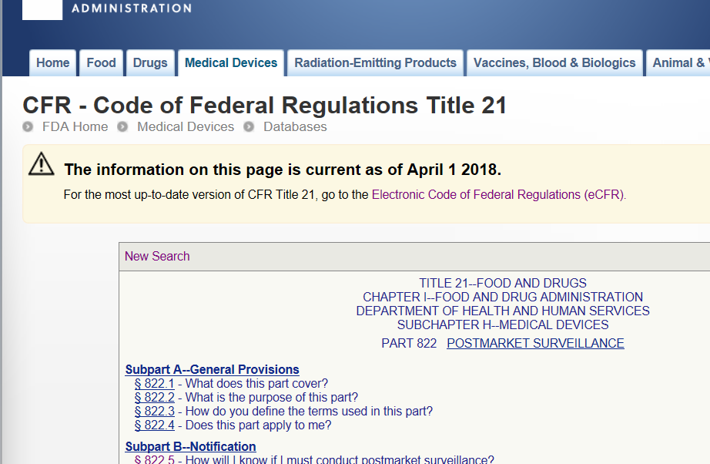
Post-market surveillance
I
For on-market products it is generally a good practice to proactively seek customer feedback on the product performance instead of relying on complaints only
For medical devices proactive collection of data is required per Federal Regulations as part of post-market surveillance to identify any problems with the product
The data are supposed to be collected during the whole time the product is on the market

Slide 15
Post-market surveillance
I
For on-market products it is generally a good practice to proactively seek customer feedback on the product performance instead of relying on complaints only
For medical devices proactive collection of data is required per Federal Regulations as part of post-market surveillance to identify any problems with the product
The data are supposed to be collected during the whole time the product is on the market

Slide 16
Post-market surveillance
I
For on-market products it is generally a good practice to proactively seek customer feedback on the product performance instead of relying on complaints only
For medical devices proactive collection of data is required per Federal Regulations as part of post-market surveillance to identify any problems with the product
The data are supposed to be collected during the whole time the product is on the market

Slide 17
Post-market surveillance
I
For on-market products it is generally a good practice to proactively seek customer feedback on the product performance instead of relying on complaints only
For medical devices proactive collection of data is required per Federal Regulations as part of post-market surveillance to identify any problems with the product
The data are supposed to be collected during the whole time the product is on the market

Slide 18
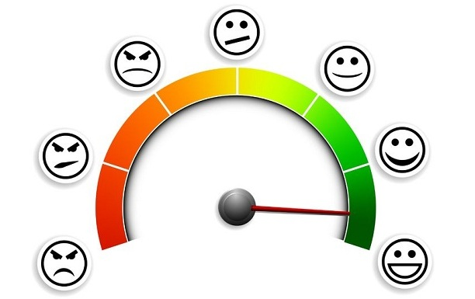
Examples of post-market data sources
I
Customer complaints
Customer polls and questionnaires
Literature search and review
Parts replacement data
Returns data
Clinical studies
Social media discussions

Slide 19
Examples of post-market data sources
I
Customer complaints
Customer polls and questionnaires
Literature search and review
Parts replacement data
Returns data
Clinical studies
Social media discussions

Slide 20
Examples of post-market data sources
I
Customer complaints
Customer polls and questionnaires
Literature search and review
Parts replacement data
Returns data
Clinical studies
Social media discussions – focus of this project

Slide 21
Examples of post-market data sources
I
Customer complaints
Customer polls and questionnaires
Literature search and review
Parts replacement data
Returns data
Clinical studies
Social media discussions – focus of this project

Slide 22

Data collection from social media
J
There are several specialized websites hosting discussion forums for specific applications of Illumina products, but the data access is limited and the data format varies significantly
For this project we chose Twitter
The length of each message is limited (280 characters)
There are already libraries available to make data gathering simpler

Slide 23
Data collection from social media
J
There are several specialized websites hosting discussion forums for specific applications of Illumina products, but the data access is limited and the data format varies significantly
For this project we chose Twitter
The length of each message is limited (280 characters)
There are already libraries available to make data gathering simpler

Slide 24
Data collection from social media
J
There are several specialized websites hosting discussion forums for specific applications of Illumina products, but the data access is limited and the data format varies significantly
For this project we chose Twitter
The length of each message is limited (280 characters)
There are already libraries available to make data gathering simpler

Slide 25
Data collection from social media
J
There are several specialized websites hosting discussion forums for specific applications of Illumina products, but the data access is limited and the data format varies significantly
For this project we chose Twitter
The length of each message is limited (280 characters)
There are already libraries available to make data gathering simpler

Slide 26
Twitter data collection
J
I
Python library “Tweepy” was used to create a script that interacts with the Twitter application programming interface (API)
Free account with Twitter allows to search and download tweets posted in the previous 7 days
We performed a query for specific keywords which mentioned Illumina products
The following keywords were used:
Illumina
MiSeq
MiniSeq
NextSeq
NovaSeq
iSeq
HiSeq
The search was case insensitive:
“ILLUMINA”, “Illumina”, “illumina”
tweet_mode="extended“ was used to obtain full text of tweets

Slide 27
Twitter data collection
J
I
Python library “Tweepy” was used to create a script that interacts with the Twitter application programming interface (API)
Free account with Twitter allows to search and download tweets posted in the previous 7 days
We performed a query for specific keywords which mentioned Illumina products
The following keywords were used:
Illumina
MiSeq
MiniSeq
NextSeq
NovaSeq
iSeq
HiSeq
The search was case insensitive:
“ILLUMINA”, “Illumina”, “illumina”
tweet_mode="extended“ was used to obtain full text of tweets

Slide 28
Twitter data collection
J
I
Python library “Tweepy” was used to create a script that interacts with the Twitter application programming interface (API)
Free account with Twitter allows to search and download tweets posted in the previous 7 days
We performed a query for specific keywords which mentioned Illumina products
The following keywords were used:
Illumina
MiSeq
MiniSeq
NextSeq
NovaSeq
iSeq
HiSeq
The search was case insensitive:
“ILLUMINA”, “Illumina”, “illumina”
tweet_mode="extended“ was used to obtain full text of tweets

Slide 29
Twitter data collection
J
I
Python library “Tweepy” was used to create a script that interacts with the Twitter application programming interface (API)
Free account with Twitter allows to search and download tweets posted in the previous 7 days
We performed a query for specific keywords which mentioned Illumina products
The following keywords were used:
Illumina
MiSeq
MiniSeq
NextSeq
NovaSeq
iSeq
HiSeq
The search was case insensitive:
“ILLUMINA”, “Illumina”, “illumina”
tweet_mode="extended“ was used to obtain full text of tweets

Slide 30
Twitter data collection
J
I
Python library “Tweepy” was used to create a script that interacts with the Twitter application programming interface (API)
Free account with Twitter allows to search and download tweets posted in the previous 7 days
We performed a query for specific keywords which mentioned Illumina products
The following keywords were used:
Illumina
MiSeq
MiniSeq
NextSeq
NovaSeq
iSeq
HiSeq
The search was case insensitive:
“ILLUMINA”, “Illumina”, “illumina”
tweet_mode="extended“ was used to obtain full text of tweets

Slide 31
Twitter data collection
J
I
Python library “Tweepy” was used to create a script that interacts with the Twitter application programming interface (API)
Free account with Twitter allows to search and download tweets posted in the previous 7 days
We performed a query for specific keywords which mentioned Illumina products
The following keywords were used:
Illumina
MiSeq
MiniSeq
NextSeq
NovaSeq
iSeq
HiSeq
The search was case insensitive:
“ILLUMINA”, “Illumina”, “illumina”
tweet_mode="extended“ was used to obtain full text of tweets

Slide 32
Twitter data collection
J
I
Python library “Tweepy” was used to create a script that interacts with the Twitter application programming interface (API)
Free account with Twitter allows to search and download tweets posted in the previous 7 days
We performed a query for specific keywords which mentioned Illumina products
The following keywords were used:
Illumina
MiSeq
MiniSeq
NextSeq
NovaSeq
iSeq
HiSeq
The search was case insensitive:
“ILLUMINA”, “Illumina”, “illumina”
tweet_mode="extended“ was used to obtain full text of tweets

Slide 33
Twitter data collection
J
I
Python library “Tweepy” was used to create a script that interacts with the Twitter application programming interface (API)
Free account with Twitter allows to search and download tweets posted in the previous 7 days
We performed a query for specific keywords which mentioned Illumina products
The following keywords were used:
Illumina
MiSeq
MiniSeq
NextSeq
NovaSeq
iSeq
HiSeq
The search was case insensitive:
“ILLUMINA”, “Illumina”, “illumina”
tweet_mode="extended“ was used to obtain full text of tweets

Slide 34
“Tweepy” return
I
['__class__', '__delattr__', '__dict__', '__dir__', '__doc__', '__eq__', '__format__', '__ge__', '__getattribute__', '__getstate__', '__gt__', '__hash__', '__init__', '__init_subclass__', '__le__', '__lt__', '__module__', '__ne__', '__new__', '__reduce__', '__reduce_ex__', '__repr__', '__setattr__', '__sizeof__', '__str__', '__subclasshook__', '__weakref__', '_api', '_json', 'author', 'contributors', 'coordinates', 'created_at', 'destroy', 'entities', 'favorite', 'favorite_count', 'favorited', 'geo', 'id', 'id_str', 'in_reply_to_screen_name', 'in_reply_to_status_id', 'in_reply_to_status_id_str', 'in_reply_to_user_id', 'in_reply_to_user_id_str', 'is_quote_status', 'lang', 'parse', 'parse_list', 'place', 'possibly_sensitive', 'retweet', 'retweet_count', 'retweeted', 'retweets', 'source', 'source_url', ‘full_text', 'truncated', 'user']
_json - JSON serializable response data as a dictionary
json.dumps extracts the data in JSON format
Only unique non-retweeted entries were collected

Slide 35
“Tweepy” return
I
['__class__', '__delattr__', '__dict__', '__dir__', '__doc__', '__eq__', '__format__', '__ge__', '__getattribute__', '__getstate__', '__gt__', '__hash__', '__init__', '__init_subclass__', '__le__', '__lt__', '__module__', '__ne__', '__new__', '__reduce__', '__reduce_ex__', '__repr__', '__setattr__', '__sizeof__', '__str__', '__subclasshook__', '__weakref__', '_api', '_json', 'author', 'contributors', 'coordinates', 'created_at', 'destroy', 'entities', 'favorite', 'favorite_count', 'favorited', 'geo', 'id', 'id_str', 'in_reply_to_screen_name', 'in_reply_to_status_id', 'in_reply_to_status_id_str', 'in_reply_to_user_id', 'in_reply_to_user_id_str', 'is_quote_status', 'lang', 'parse', 'parse_list', 'place', 'possibly_sensitive', 'retweet', 'retweet_count', 'retweeted', 'retweets', 'source', 'source_url', ‘full_text', 'truncated', 'user']
_json - JSON serializable response data as a dictionary
json.dumps extracts the data in JSON format
Only unique non-retweeted entries were collected

Slide 36
“Tweepy” return
I
['__class__', '__delattr__', '__dict__', '__dir__', '__doc__', '__eq__', '__format__', '__ge__', '__getattribute__', '__getstate__', '__gt__', '__hash__', '__init__', '__init_subclass__', '__le__', '__lt__', '__module__', '__ne__', '__new__', '__reduce__', '__reduce_ex__', '__repr__', '__setattr__', '__sizeof__', '__str__', '__subclasshook__', '__weakref__', '_api', '_json', 'author', 'contributors', 'coordinates', 'created_at', 'destroy', 'entities', 'favorite', 'favorite_count', 'favorited', 'geo', 'id', 'id_str', 'in_reply_to_screen_name', 'in_reply_to_status_id', 'in_reply_to_status_id_str', 'in_reply_to_user_id', 'in_reply_to_user_id_str', 'is_quote_status', 'lang', 'parse', 'parse_list', 'place', 'possibly_sensitive', 'retweet', 'retweet_count', 'retweeted', 'retweets', 'source', 'source_url', ‘full_text', 'truncated', 'user']
_json - JSON serializable response data as a dictionary
json.dumps extracts the data in JSON format
Only unique non-retweeted entries were collected

Slide 37
“Tweepy” return
I
['__class__', '__delattr__', '__dict__', '__dir__', '__doc__', '__eq__', '__format__', '__ge__', '__getattribute__', '__getstate__', '__gt__', '__hash__', '__init__', '__init_subclass__', '__le__', '__lt__', '__module__', '__ne__', '__new__', '__reduce__', '__reduce_ex__', '__repr__', '__setattr__', '__sizeof__', '__str__', '__subclasshook__', '__weakref__', '_api', '_json', 'author', 'contributors', 'coordinates', 'created_at', 'destroy', 'entities', 'favorite', 'favorite_count', 'favorited', 'geo', 'id', 'id_str', 'in_reply_to_screen_name', 'in_reply_to_status_id', 'in_reply_to_status_id_str', 'in_reply_to_user_id', 'in_reply_to_user_id_str', 'is_quote_status', 'lang', 'parse', 'parse_list', 'place', 'possibly_sensitive', 'retweet', 'retweet_count', 'retweeted', 'retweets', 'source', 'source_url', ‘full_text', 'truncated', 'user']
_json - JSON serializable response data as a dictionary
json.dumps extracts the data in JSON format
Only unique non-retweeted entries were collected

Slide 38
“Tweepy” return
I
['__class__', '__delattr__', '__dict__', '__dir__', '__doc__', '__eq__', '__format__', '__ge__', '__getattribute__', '__getstate__', '__gt__', '__hash__', '__init__', '__init_subclass__', '__le__', '__lt__', '__module__', '__ne__', '__new__', '__reduce__', '__reduce_ex__', '__repr__', '__setattr__', '__sizeof__', '__str__', '__subclasshook__', '__weakref__', '_api', '_json', 'author', 'contributors', 'coordinates', 'created_at', 'destroy', 'entities', 'favorite', 'favorite_count', 'favorited', 'geo', 'id', 'id_str', 'in_reply_to_screen_name', 'in_reply_to_status_id', 'in_reply_to_status_id_str', 'in_reply_to_user_id', 'in_reply_to_user_id_str', 'is_quote_status', 'lang', 'parse', 'parse_list', 'place', 'possibly_sensitive', 'retweet', 'retweet_count', 'retweeted', 'retweets', 'source', 'source_url', ‘full_text', 'truncated', 'user']
_json - JSON serializable response data as a dictionary
json.dumps extracts the data in JSON format
Only unique non-retweeted entries were collected

Slide 39
“Tweepy” return
I
['__class__', '__delattr__', '__dict__', '__dir__', '__doc__', '__eq__', '__format__', '__ge__', '__getattribute__', '__getstate__', '__gt__', '__hash__', '__init__', '__init_subclass__', '__le__', '__lt__', '__module__', '__ne__', '__new__', '__reduce__', '__reduce_ex__', '__repr__', '__setattr__', '__sizeof__', '__str__', '__subclasshook__', '__weakref__', '_api', '_json', 'author', 'contributors', 'coordinates', 'created_at', 'destroy', 'entities', 'favorite', 'favorite_count', 'favorited', 'geo', 'id', 'id_str', 'in_reply_to_screen_name', 'in_reply_to_status_id', 'in_reply_to_status_id_str', 'in_reply_to_user_id', 'in_reply_to_user_id_str', 'is_quote_status', 'lang', 'parse', 'parse_list', 'place', 'possibly_sensitive', 'retweet', 'retweet_count', 'retweeted', 'retweets', 'source', 'source_url', ‘full_text', 'truncated', 'user']
_json - JSON serializable response data as a dictionary
json.dumps extracts the data in JSON format
Only unique non-retweeted entries were collected

Slide 40
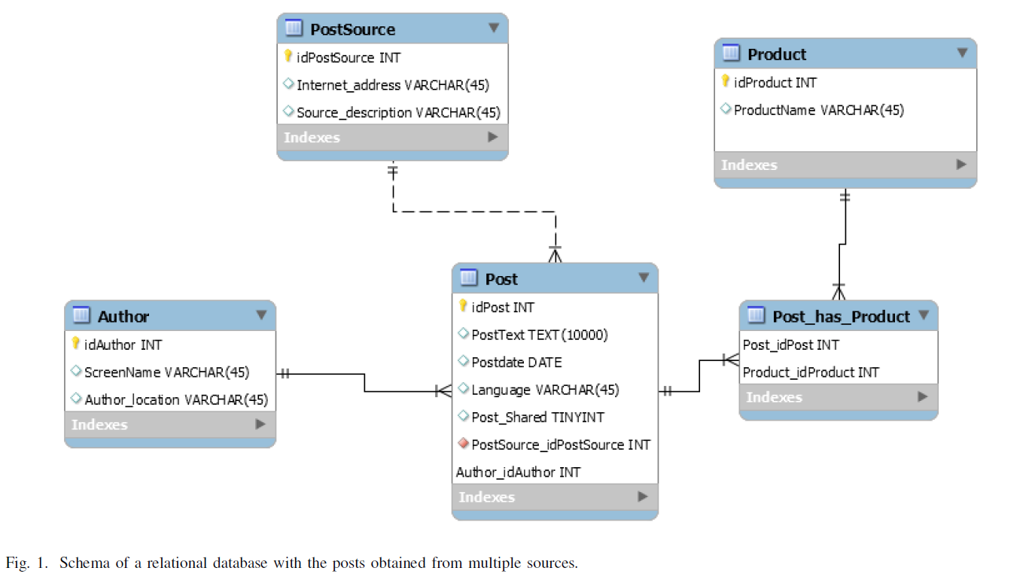
Database plan
A
Initial Plan – Relational database in MySQL
This schema would cover needs of collecting data from multiple sources

Slide 41
Database plan
A
Initial Plan – Relational database in MySQL
This schema would cover needs of collecting data from multiple sources

Slide 42
Database plan
A
Initial Plan – Relational database in MySQL
This schema would cover needs of collecting data from multiple sources

Slide 43
Database plan
A
Initial Plan – Relational database in MySQL
This schema would cover needs of collecting data from multiple sources

Slide 44
Database plan
A
Initial Plan – Relational database in MySQL
This schema would cover needs of collecting data from multiple sources

Slide 45
Database plan
A
Initial Plan – Relational database in MySQL
This schema would cover needs of collecting data from multiple sources

Slide 46
Database plan (cont.)
A
Based on new learnings, time available for the project and availability of JSON output - MongoDB

Slide 47
Database plan (cont.)
A
Based on new learnings, time available for the project and availability of JSON output - MongoDB

Slide 48


Database plan
A
I
Final Plan - MongoDB
mongoimport tool imports content from an Extended JSON, CSV, or TSV export created
Since only 1 week of data was available at a time, the database was updated with new data as it became available
“upsert” function to append new records

Slide 49
Database plan
A
I
Final Plan - MongoDB
mongoimport tool imports content from an Extended JSON, CSV, or TSV export created
Since only 1 week of data was available at a time, the database was updated with new data as it became available
“upsert” function to append new records

Slide 50
Database plan
A
I
Final Plan - MongoDB
mongoimport tool imports content from an Extended JSON, CSV, or TSV export created
Since only 1 week of data was available at a time, the database was updated with new data as it became available
“upsert” function to append new records

Slide 51
Database plan
A
I
Final Plan - MongoDB
mongoimport tool imports content from an Extended JSON, CSV, or TSV export created
Since only 1 week of data was available at a time, the database was updated with new data as it became available
“upsert” function to append new records

Slide 52
Database plan
A
I
Final Plan - MongoDB
mongoimport tool imports content from an Extended JSON, CSV, or TSV export created
Since only 1 week of data was available at a time, the database was updated with new data as it became available
“upsert” function to append new records

Slide 53
Database plan
A
I
Final Plan - MongoDB
mongoimport tool imports content from an Extended JSON, CSV, or TSV export created
Since only 1 week of data was available at a time, the database was updated with new data as it became available
“upsert” function to append new records

Slide 54
Database plan
A
I
Final Plan - MongoDB
mongoimport tool imports content from an Extended JSON, CSV, or TSV export created
Since only 1 week of data was available at a time, the database was updated with new data as it became available
“upsert” function to append new records

Slide 55
Database plan
A
I
Final Plan - MongoDB
mongoimport tool imports content from an Extended JSON, CSV, or TSV export created
Since only 1 week of data was available at a time, the database was updated with new data as it became available
“upsert” function to append new records

Slide 56
Natural Language Processing
J
NLP - the process of augmenting human communication with the capabilities found in statistics, machine learning, and the evolving computer science ecosystem.
The general concept of NLP is to systematically breakdown the elements of text, classifying the elements, and predicting the intent of the communication.
Only recently, has the computer processing power and infrastructure been made available to combine with tried and true statistical concepts, to make this possible.
For our project, the intent was to capture unstructured data found in segments of text posted on the internet (Twitter texts) and discover the insights that would create a feedback loop to Illumina.

Slide 57
Natural Language Processing
J
NLP - the process of augmenting human communication with the capabilities found in statistics, machine learning, and the evolving computer science ecosystem.
The general concept of NLP is to systematically breakdown the elements of text, classifying the elements, and predicting the intent of the communication.
Only recently, has the computer processing power and infrastructure been made available to combine with tried and true statistical concepts, to make this possible.
For our project, the intent was to capture unstructured data found in segments of text posted on the internet (Twitter texts) and discover the insights that would create a feedback loop to Illumina.

Slide 58
Natural Language Processing
J
NLP - the process of augmenting human communication with the capabilities found in statistics, machine learning, and the evolving computer science ecosystem.
The general concept of NLP is to systematically breakdown the elements of text, classifying the elements, and predicting the intent of the communication.
Only recently, has the computer processing power and infrastructure been made available to combine with tried and true statistical concepts, to make this possible.
For our project, the intent was to capture unstructured data found in segments of text posted on the internet (Twitter texts) and discover the insights that would create a feedback loop to Illumina.

Slide 59
Natural Language Processing
J
NLP - the process of augmenting human communication with the capabilities found in statistics, machine learning, and the evolving computer science ecosystem.
The general concept of NLP is to systematically breakdown the elements of text, classifying the elements, and predicting the intent of the communication.
Only recently, has the computer processing power and infrastructure been made available to combine with tried and true statistical concepts, to make this possible.
For our project, the intent was to capture unstructured data found in segments of text posted on the internet (Twitter texts) and discover the insights that would create a feedback loop to Illumina.

Slide 60
Natural Language Processing
J
NLP - the process of augmenting human communication with the capabilities found in statistics, machine learning, and the evolving computer science ecosystem.
The general concept of NLP is to systematically breakdown the elements of text, classifying the elements, and predicting the intent of the communication.
Only recently, has the computer processing power and infrastructure been made available to combine with tried and true statistical concepts, to make this possible.
For our project, the intent was to capture unstructured data found in segments of text posted on the internet (Twitter texts) and discover the insights that would create a feedback loop to Illumina.

Slide 61
Natural Language Processing
J
NLP - the process of augmenting human communication with the capabilities found in statistics, machine learning, and the evolving computer science ecosystem.
The general concept of NLP is to systematically breakdown the elements of text, classifying the elements, and predicting the intent of the communication.
Only recently, has the computer processing power and infrastructure been made available to combine with tried and true statistical concepts, to make this possible.
For our project, the intent was to capture unstructured data found in segments of text posted on the internet (Twitter texts) and discover the insights that would create a feedback loop to Illumina.

Slide 62
Natural Language Processing
J
NLP - the process of augmenting human communication with the capabilities found in statistics, machine learning, and the evolving computer science ecosystem.
The general concept of NLP is to systematically breakdown the elements of text, classifying the elements, and predicting the intent of the communication.
Only recently, has the computer processing power and infrastructure been made available to combine with tried and true statistical concepts, to make this possible.
For our project, the intent was to capture unstructured data found in segments of text posted on the internet (Twitter texts) and discover the insights that would create a feedback loop to Illumina.

Slide 63
Natural Language Processing (cont.)
J
Queried MongoDB with Python
Established connection with MongoDB using “pymongo” library and query the data
Used “textblob” library for rudimentary Natural Language Processing
TextBlob allows to detect language and translate into English
Although not perfect – allows to analyze tweets in other languages
TextBlob was used to run a sentiment polarity analysis

Slide 64
Natural language processing
J
Queried MongoDB with Python
Established connection with MongoDB using “pymongo” library and query the data
Used “textblob” library for rudimentary Natural Language Processing
TextBlob allows to detect language and translate into English
Although not perfect – allows to analyze tweets in other languages
TextBlob was used to run a sentiment polarity analysis

Slide 65
Natural language processing
J
Queried MongoDB with Python
Established connection with MongoDB using “pymongo” library and query the data
Used “textblob” library for rudimentary Natural Language Processing
TextBlob allows to detect language and translate into English
Although not perfect – allows to analyze tweets in other languages
TextBlob was used to run a sentiment polarity analysis

Slide 66
Natural language processing
J
Queried MongoDB with Python
Established connection with MongoDB using “pymongo” library and query the data
Used “textblob” library for rudimentary Natural Language Processing
TextBlob allows to detect language and translate into English
Although not perfect – allows to analyze tweets in other languages
TextBlob was used to run a sentiment polarity analysis

Slide 67
Natural language processing
J
Queried MongoDB with Python
Established connection with MongoDB using “pymongo” library and query the data
Used “textblob” library for rudimentary Natural Language Processing
TextBlob allows to detect language and translate into English
Although not perfect – allows to analyze tweets in other languages
TextBlob was used to run a sentiment polarity analysis

Slide 68
Natural language processing
J
Queried MongoDB with Python
Established connection with MongoDB using “pymongo” library and query the data
Used “textblob” library for rudimentary Natural Language Processing
TextBlob allows to detect language and translate into English
Although not perfect – allows to analyze tweets in other languages
TextBlob was used to run a sentiment polarity analysis

Slide 69
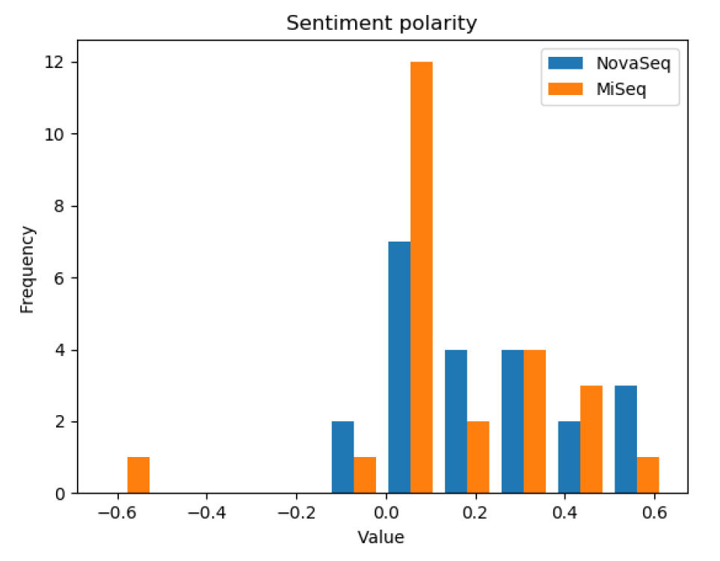


Natural language processing Sentiment Polarity Analysis
J
Sentiment polarity for 2 Illumina products

Slide 70
Natural language processing Sentiment Polarity Analysis
J
Sentiment polarity for 2 Illumina products

Slide 71
Natural language processing Sentiment Polarity Analysis
J
Sentiment polarity for 2 Illumina products

Slide 72
Natural language processing Sentiment Polarity Analysis
J
Sentiment polarity for 2 Illumina products

Slide 73

Natural Language Processing Sentiment Analysis “Pitfalls”!
J

Slide 74
Natural Language Processing Sentiment Analysis “Pitfalls”!
J
”Just shy of 4 TeraBases for our S4 NovaSeq run. That is seriously mad!”

Slide 75

Natural Language Processing Sentiment Analysis “Pitfalls”!
J
”Just shy of 4 TeraBases for our S4 NovaSeq run. That is seriously mad!”
-Score very low
-Reality very positive

Slide 76
Natural Language Processing Sentiment Analysis “Pitfalls”!
J
”Just shy of 4 TeraBases for our S4 NovaSeq run. That is seriously mad!”
-Score very low
-Reality very positive

Slide 77
Natural Language Processing Sentiment Analysis “Pitfalls”!
J
”Just shy of 4 TeraBases for our S4 NovaSeq run. That is seriously mad!”
-Score very low
-Reality very positive

Slide 78
Natural Language Processing Sentiment Analysis “Pitfalls”!
J
”Just shy of 4 TeraBases for our S4 NovaSeq run. That is seriously mad!”
-Score very low
-Reality very positive

Slide 79
Conclusions
I
Social media data were collected from the internet with Python script
Scalable MongoDB database was created
DB was utilized for actual analysis of the performance of the product

Slide 80
Conclusions
I
Social media data were collected from the internet with Python script
Scalable MongoDB database was created
DB was utilized for actual analysis of the performance of the product

Slide 81
Conclusions
I
Social media data were collected from the internet with Python script
Scalable MongoDB database was created
DB was utilized for actual analysis of the performance of the product

Slide 82
Conclusions
I
Social media data were collected from the internet with Python script
Scalable MongoDB database was created
DB was utilized for actual analysis of the performance of the product

Slide 83
Questions?

